Slide 1
In Our Own Hands Why teachers of writing should write
Camden Conference
‘Reclaiming English’
Berkshire, 4 July 2014
Simon Wrigley, NWP Director

Slide 2
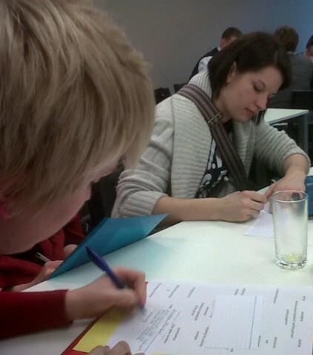
Writing: verbal substantive 1 or 2?
The occupation of writing
Keats: “…fine writing is, next to fine doing, the top thing in the world.”

Slide 3
50 years research on writing: what have we learnt?
When students attend to improving content and purpose, discussing details and feelings, writing improves more than when they attend to the forms and structures.
(George Hillocks, Chicago)
To grow, young writers need a teacher who cares about what they want to say, and low stakes writing opportunities in which they can invest emotionally.
(Peter Elbow, Massachusetts)
Youtube nwp.org.us conversation 2008

Slide 4
What’s wrong with the tests? (The atomisation of process)
Mark scheme for 2013 KS2 Level 6 writing test:
‘AF1 – write imaginative and thoughtful texts no longer constitutes part of the mark scheme as the task’s focus is on grammar, punctuation, vocabulary and appropriacy. AF1 will be assessed by teacher assessment of pupils’ compositional writing only.’

Slide 5
“Accountability is what’s left when responsibility is taken away.”
Pasi Sahlberg, Finnish Education Director 2013

Slide 6
Authors, authority and authenticity
‘If you limp around long enough in someone else’s language, you may eventually learn to walk in it.’
James Britton 1982
‘Classrooms would be transformed if pupils wrote what they wanted to write, rather than what their teachers told them to write.’
Harold Rosen 1969

Slide 7
NWP and nwp
How are we presenting the task of writing to children? How has writing been defined by the way in which we evaluate it? …NWP 1990
What happens if we look for that which is authentic & distinctive in writing, rather than that which conforms to standards? …nwp 2011
Notes:
Worth saying that Sue Horner – ex English lead on QCDA and now joint architect of the survey ‘Looking for the Heart of English (LHE)’ was on the editorial board of the first UK NWP in the 1990s. However, although aware of presentational variance and the effect on writers of the prospect of evaluation and assessment practices, she later presided over an assessment system of y measured and tests which reduced writing to what could be more easily measured, recorded and ranked.
It’s not that an understanding of the public face and social priorities of writing shouldn’t be acknowledged, it’s that there are other ‘affordances’ of writing tend to get ignored, especially ‘expressive’ writing, and the non-judgemental talk which can beneficially surround it.
An answer to the second question is that we start to value that which is distinctive in the individual perception and voice – and writers are encouraged for being heard for their messages and their intentions, rather than for their products and their styles.

Slide 8
‘Teachers of writing should write.’
Richard Andrews 2008
Is this an indulgence?
EE (TAW)

Slide 9
What’s new in 2014?
Ofsted’s 2013 school report calls for greater creativity and independence
Demand for AQA Creative Writing A level for 2015 exam (50 students in some schools and institutions)
Exponential growth in online writing
102 Higher Ed institutions offer degree in CA whatuni.com (compared to 3 in 1973?)

Slide 10
nwp.org.uk
Teachers as agents of reform
Professional development through shared creativity
Sustained partnership in research
Free and structured approaches
Groups collecting evidence of writing journeys

Slide 11
Teachers write together …

Slide 12
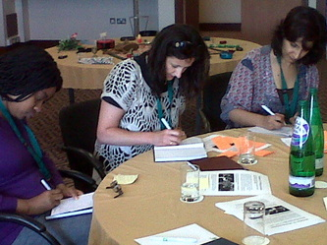
…inside …

Slide 13
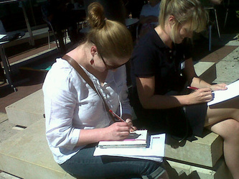
… and outside.

Slide 14
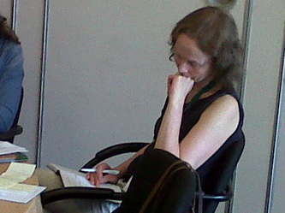
They think …

Slide 15
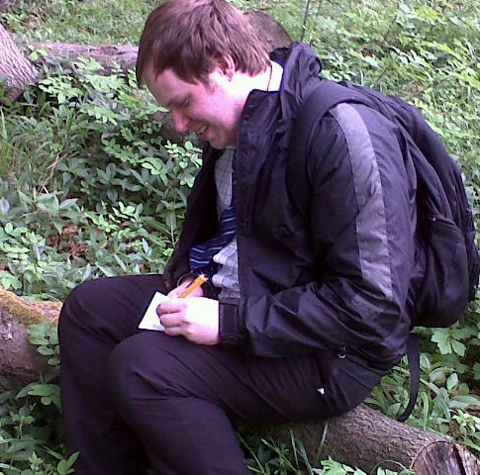
…they
write …

Slide 16
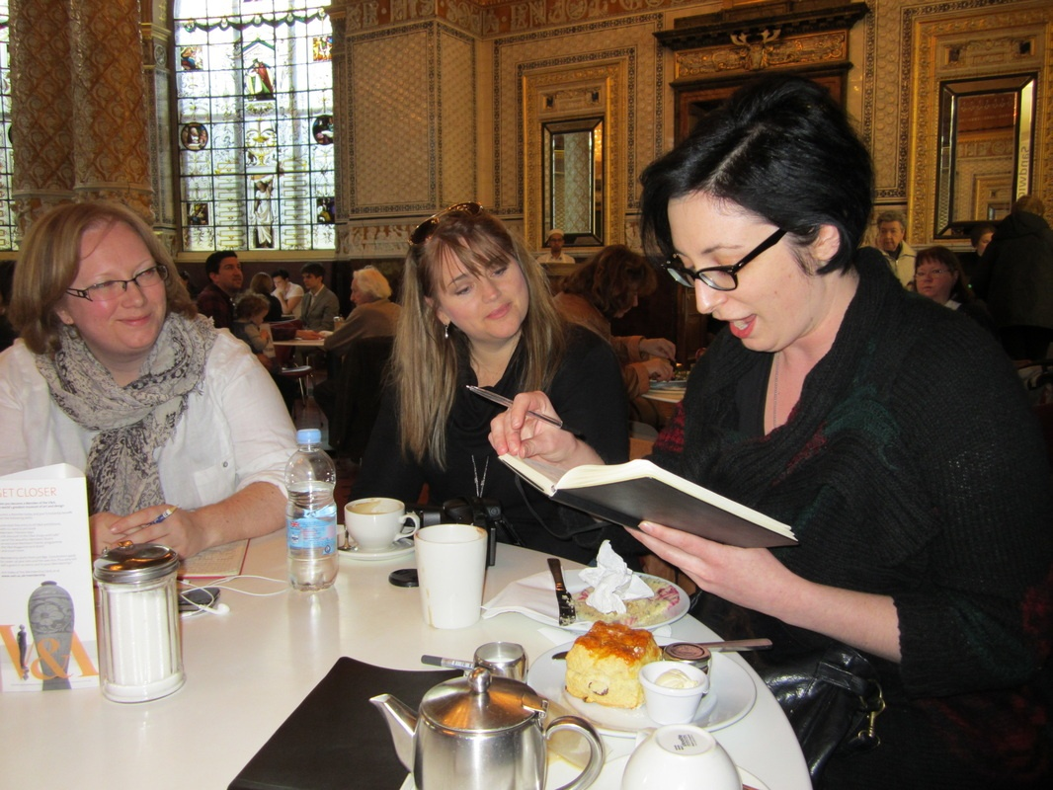
… they share …

Slide 17
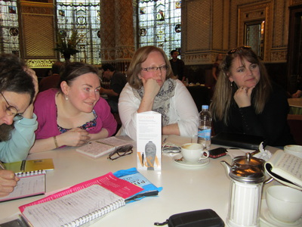
… they listen …

Slide 18
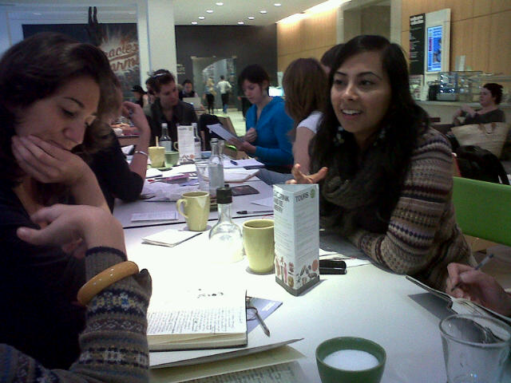
… and they respond.

Slide 19
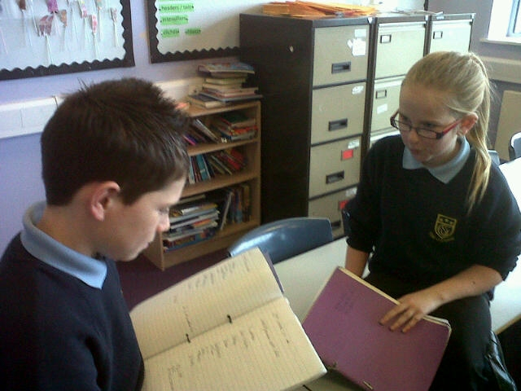
And their pupils do the same.

Slide 20
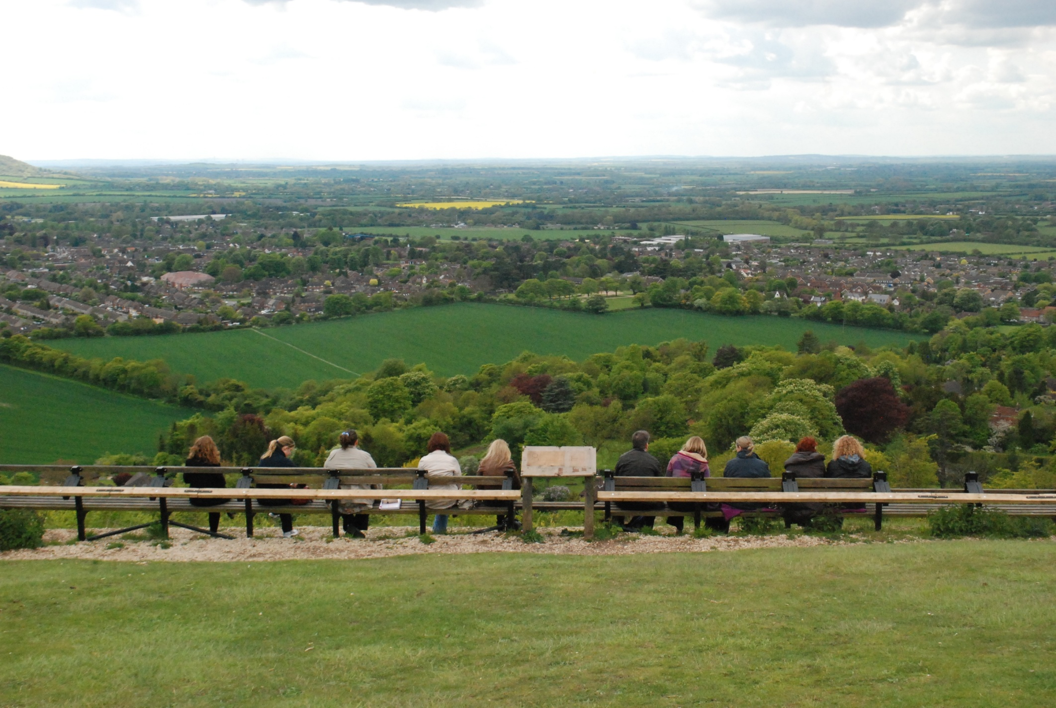

Slide 21
Emma’s Whiteleaf writing
… The intersection of hope and decay, summer and winter and time passing. Signposts offer someone else's direction. I want to walk a different way. I want to walk to the edge. I feel myself float - red kite soul pushed high by the wind that blows around me, surrounds me. Crossing and re-crossing intersections of field by hedgerow, skyline by thrust of tree. Time present intersects with memories of an Autumn walk, a springtime picnic. Intersections woven on a hilltop, tattooed across my perspective.
Life is hard says decay...

Slide 22
Responses to Emma’s writing
… I am fascinated by the way … that you place yourself imaginatively and emotionally in the landscape. JS
I think the idea of standing on the edge is always exciting and full of possibilities… SB
…You capture the ephemeral quality of all life, quickly passing, and the imperative to join the dance before it's too late… AB
… Wonderful how this windy song on this risky edge resonates with you! Is that Marvell - 'green thoughts in a green shade‘? …SW
Yes, one of my favourite lines in a favourite poem -annihilation into green! I love going to Whiteleaf! EE

Slide 23
Writing Teachers: UEA
This group is formed of new and experienced teachers. We spend part of the time writing and responding to each other’s writing and part of the time discussing classroom practice in relation to writing. We are building a body of research about writing and writing groups.
Jeni.Smith@uea.ac.uk
01603-592622

Slide 24
Where has this got us in 5 years?
28 teachers' writing groups across the UK
over 200 teachers involved online and many more in face-to-face group meetings
Over 10,000 website hits a month (June 2014 nwp.org.uk)
1,000s of children more engaged as writers
4 summer conferences featuring NWP in workshops and on the platform
ongoing research into the effects of teachers running their own writing groups
forthcoming Routledge publication and NWP/Arvon residential writing weeks

Slide 25
NWP groups in UK 2014

Slide 26
Is it worth it?
"I like the approach adopted by the NWP where pupils experiment with writing."
Tricia Metham, HMI National Lead for English, 14.3.2014, at the NAAE conference in Birmingham:

Slide 27
Better English and Literacy
What ‘ups’ have our surveys shown?
Encouraging pupils to play with language, free from formal assessment
Using marking to generate genuine dialogue with pupils about their work
Giving pupils choice of text type and topic
Creating opportunities to write on-line

Slide 28
Better English and Literacy
The Gold Standard
Teachers demonstrate high standards in their own use of language.
They model the processes of reading and writing powerfully to help pupils make real progress in their own work.
English subject inspection: a mark of outstanding teaching

Slide 29
What do teachers say?
Katherine, NWP Whodunnit 2013-2014 “You have to be totally on board .. they're still surprised that I write with them. They're intrigued. They don't see people writing - although they see the product... they're liberated by not being daunted by it. I don't find the blank page so scary now and I write more outside the group - more than I have for 20 years." Lindsey, NWP Whodunnit 2013-2014 "It really reconnects you to your subject - it is vital to be connected - you're trying to get kids to love what you already love... I shared my own writing - I had enthusiasm from what I'd found exciting ... I got creative writing from this boy who'd never liked writing before."

Slide 30
Why join a teachers’ writing group?
‘Inhabit your life more fully’ – use your creative energy
Discover your personal and professional voice
Gather evidence with others and strengthen your professional identity and confidence
Adapt the writing process in your classroom
Engage more pupils with writing as independent and expert writers & responders

Slide 31
Thank you. Now, please, for your own sake and the sake of your children, join or start a writing group. We will support you. And you will be strengthening the expertise and voice of the profession.
nwp.org.uk
jeni.smith@uea.ac.uk
simonjohnwrigley@gmail.com

