Slide 1
Better English and Literacy
The Ups and Downs of Writing – an Ofsted Perspective
Patricia Metham HMI
National Lead for English & Literacy

Slide 2
Better English and Literacy
How do
schools
balance
the
demands?

Slide 3
Better English and Literacy
The NC requires all pupils to:
acquire a wide vocabulary, an understanding of grammar and knowledge of linguistic conventions
write clearly, accurately and coherently, adapting language and style for a range of contexts, purposes and audiences.

Slide 4
Better English and Literacy
GCSE English Language will assess pupils’ ability to:
write clear, coherent and effective texts
apply an understanding of tone, style and register, including spelling and grammar
write for a range of purposes and audiences.

Slide 5
Better English and Literacy
What do pupils tell us they want?
To write, at length, on topics and in a style of their choice
To experiment with language, free from the inhibitions of assessment
To be able to ‘get it right’ when they need to.

Slide 6
The ‘downs’ No-one says it’s easy!

Slide 7
Better English and Literacy
In 2012, a National Literacy Trust survey found that:
one in every six adults struggles with literacy, with a literacy level below that expected of an 11-year-old
levels of achievement are often associated with pupils’ levels of deprivation.

Slide 8
Better English and Literacy
Persistent challenges identified in a government survey include:
the gap between girls’ and boys’ achievement, especially in writing
evidence of lower standards overall in writing
poorer performance in English by pupils eligible for free school meals.
Notes:
The importance of teaching: schools White Paper, Department for Education, 2010
www.education.gov.uk/schools/teachingandlearning/schoolswhitepaper/b0068570/the-importance-of-teaching

Slide 9
Better English and Literacy
Barriers to success for boys:
poor behaviour
low levels of motivation
low self-esteem and reluctance to risk failure
a reluctance to begin writing
Notes:
Beyond the Crossroads, 2009
The National Advisor’s report on a day’s seminars with English teachers, following publication of English at the Crossroads.

Slide 10
Better English and Literacy
Try reversing the sequence.
Barriers to success for boys include:
reluctance to begin writing (because of…)
low self-esteem and reluctance to risk failure (leading to…)
low levels of motivation (prompting…)
poor behaviour.

Slide 11
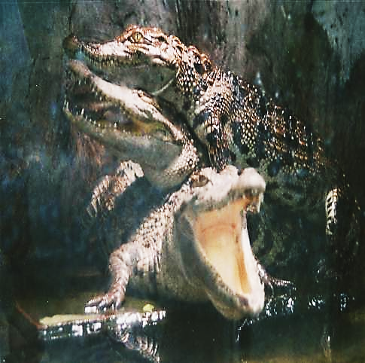
Better English and Literacy
Obstacles
‘What Ofsted expects’
the fears
Notes:
TNM collection

Slide 12
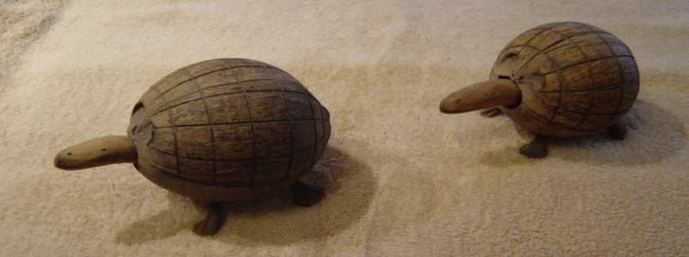
Better English and Literacy
Frustrations
Weaknesses in leadership:
little direction or identity for English
allowing curriculum development to lag behind pupils’ changing needs
Notes:
TNM collection

Slide 13
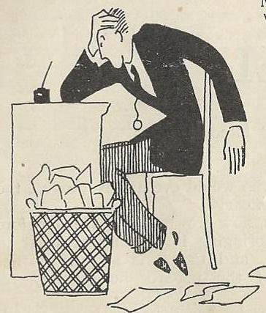
Better English and Literacy
Problems
Nervous teachers:
limited subject knowledge
lack of confidence in their own skills as writers
fear of the unplanned
teaching to the test
Notes:
The Family’, Harry Graham, Pearson’s Magazine July 1925, No.355
Out of copyright

Slide 14
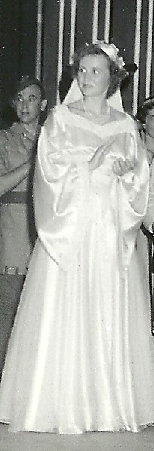
Better English and Literacy
Diversions
The prima donna
in the classroom
Notes:
TPM collection

Slide 15
The ‘ups’

Slide 16
Better English and Literacy
What ‘ups’ have our surveys shown?
Teachers and pupils working together as writers
Combining a variety of experiences and approaches
Encouraging pupils to develop their own success criteria

Slide 17
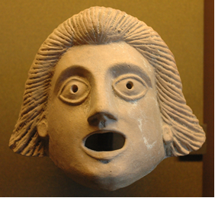
Better English and Literacy
Activity 1 Write a haiku about ‘fear’ or ‘surprise’ or in response to one of these images (5,7,5 syllables).
Share your haiku.
Notes:
http://upload.wikimedia.org/wikipedia/commons/6/64/Mask_youngster_Louvre_S3044.jpg
http://commons.wikimedia.org/wiki/File:Dead_Tree_-_geograph.org.uk_-_1737363.jpg
http://en.wikipedia.org/wiki/File:Melongena_corona_2.jpg

Slide 18
Better English and Literacy
What ‘ups’ have our surveys shown?
Encouraging pupils to play with language, free from formal assessment
Using marking to generate genuine dialogue with pupils about their work
Giving pupils choice of text type and topic
Creating opportunities to write on-line

Slide 19
Better English and Literacy
The Gold Standard
Teachers demonstrate high standards in their own use of language.
They model the processes of reading and writing powerfully to help pupils make real progress in their own work.
English subject inspection: a mark of outstanding teaching

Slide 20
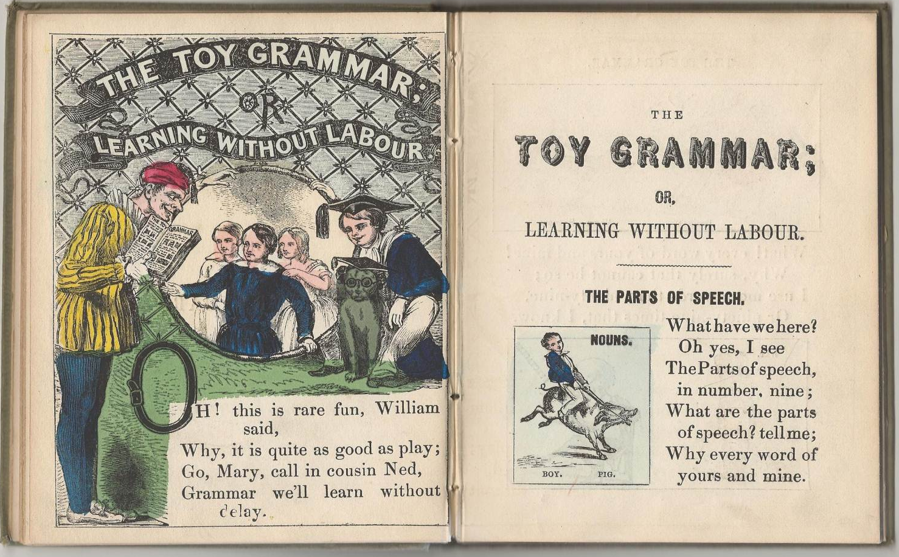
Tools of the trade
Notes:
The Toy Grammar or Learning Without Labour
A child’s primer c.1855

Slide 21
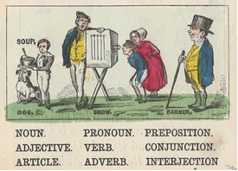
Better English and Literacy
SPaG:
the object of the exercise
or
the means to an important end?
Notes:
The Toy Grammar or Learning Without Labour
A child’s primer c.1855

Slide 22
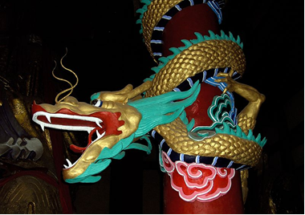
Better English and Literacy
Lack of punctuation can be lethal!
im hungry lets eat granny
Notes:
http://en.wikipedia.org/wiki/Dragohttp://en.wikipedia.org/wiki/Dragon

Slide 23
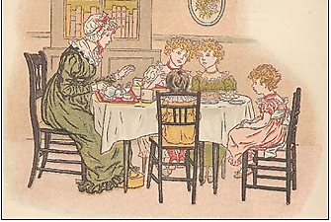
Better English and Literacy
Correct punctuation saves the day – and Granny!
‘I’m hungry! Let’s eat, Granny.’
Notes:
Kate Greenaway Little Anne – out of copyright

Slide 24
Better English and Literacy
Woman without her man is nothing.

Slide 25
Better English and Literacy
Woman without her man is nothing.
Woman, without her man, is nothing.

Slide 26
Better English and Literacy
Punctuation is the reader’s sat. nav.
Woman without her man is nothing.
Woman, without her man, is nothing.
Woman: without her, man is nothing.
Notes:
http://www.englishforeveryone.org/Topics/Terms-of-Use.htm

Slide 27
Better English and Literacy
Making choices: modal verbs
Imagine you are the English team coach trying to inspire the team.
‘We can win this.’ ‘We should win this.’
‘We must win this.’ ‘We will win this.’
Hear each of these possibilities.
Consider the impact of verb choice.
Notes:
Exeter University research project: Contextual teaching of grammar

Slide 28
Better English and Literacy
Making choices: sentence structure
His wife was shrill, languid, handsome and horrible.
His wife was horrible, shrill, languid and handsome.
Hear each version. What difference does the change of word order make?
Is one more effective than the other?
Notes:
The Great Gatsby, F. Scott Fitzgerald
The first version is Scott Fitzgerald’s

Slide 29
Reading to write

Slide 30
Better English and Literacy
The NC calls for all pupils to read:
good fiction & non-fiction, poetry & prose from ‘our literary heritage’, film & digital texts - across subjects
seminal world literature written in English.
How do you interpret ‘our literary heritage’?
How might you use such reading to develop pupils’ writing?

Slide 31
Better English and Literacy
Activity 2 Discuss how a close reading in class of the extract from 1984 or ‘Beloved’ or the ‘The first tanks in action’ might support pupils’ writing.
‘It was a bright cold day in April, and the clocks were striking thirteen. Winston Smith, his chin nuzzled into his breast in an effort to escape the vile wind, slipped quickly through the glass doors of Victory Mansions, though not quickly enough to prevent a swirl of gritty dust from entering along with him.’ 1984, George Orwell

Slide 32
Better English and Literacy
Activity 2
Winston Smith, his chin nuzzled into his breast in an effort to escape the vile wind, slipped quickly through the glass doors of Victory Mansions, though not quickly enough to prevent a swirl of gritty dust from entering along with him. It was a bright cold day in April, and the clocks were striking thirteen.
What difference does the changed sentence order make to the reader?

Slide 33
Better English and Literacy
‘124 was spiteful. Full of a baby’s venom. The women in the house knew it and so did the children. For years each put up with the spite in his own way, but by 1873 Sethe and her daughter Denver were its only victims. The grandmother, Baby Suggs, was dead, and the sons, Howard and Buglar, had run away by the time they were thirteen years old – as soon as merely looking in a mirror shattered it (that was the signal for Buglar); as soon as two tiny hand prints appeared in the cake (that was it for Howard).’
The opening of Beloved by Toni Morrison, 1987
–

Slide 34
Better English and Literacy
The first tanks in action, 15 September 1916
‘We heard strange throbbing noises, and lumbering slowly towards us came three huge mechanical monsters such as we had never seen before. My first impression was that they looked ready to topple on their noses, but their tails and two little wheels at the back held them down and kept them level. Big metal things they were, with two sets of caterpillar wheels that went right round the body.’
The Faber Book of Reportage, edited by John Carey, p.464

Slide 35
The challenge Better English and Literacy
Literacy English
Notes:
35
http://commons.wikimedia.org/wiki/File:Balanced_scale_of_Justice.svg

Slide 36
Better English and Literacy
Key message
The NC sets out non-negotiables in terms of skills and knowledge.
You have the freedom to develop these through an engaging curriculum.
You have the responsibility to promote the learning of all pupils in your school.

Slide 37
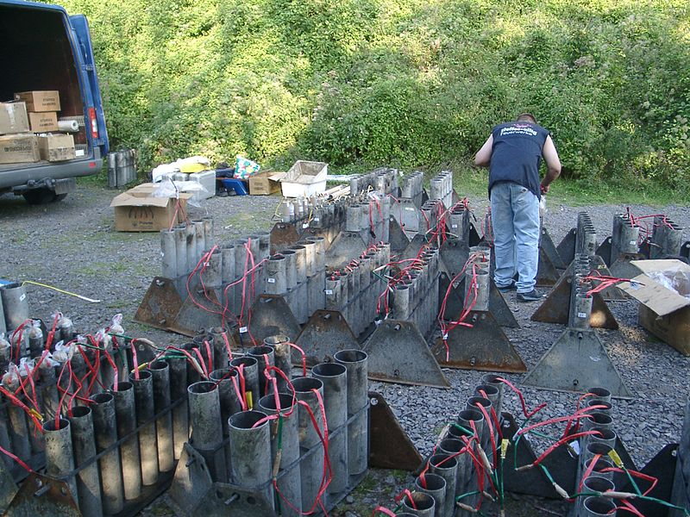
Better English and Literacy
The ‘Wow!’ approach to writing?
Planning choices
and
priorities?
Notes:
Preparing a firework display at Sayn Castle Germany
Photograph by Klaus Graf, 03.09.2005
http://commons.wikimedia.org/wiki/File:Preparing_Firework.jpg
Copyright-free

Slide 38
Better English and Literacy
The ‘Wow!’ approach to writing?
Notes:
White fireworks go off over parliament hill, Canada Day, 1 July 2011
By: Leafsfan67
Copyright-free
http://en.wikipedia.org/wiki/File:Fireworks_on_Canada_DAY.jpg
Copyright free

Slide 39
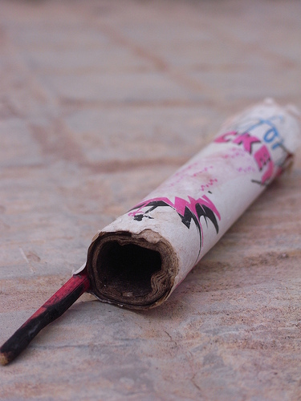
Better English and Literacy
The ‘Wow!’ approach to writing?
Notes:
http://www.flickr.com/photos/dar1977/3758951750/in/pool-1157160@N24
Copyright-free

Slide 40
Better English and Literacy
The ‘Wow!’ approach to writing?
Does the ‘Wow!’ lead somewhere purposeful?
How will it inspire pupils’ writing?
Notes:
http://www.flickr.com/photos/dar1977/3758951750/in/pool-1157160@N24
Copyright-free

Slide 41
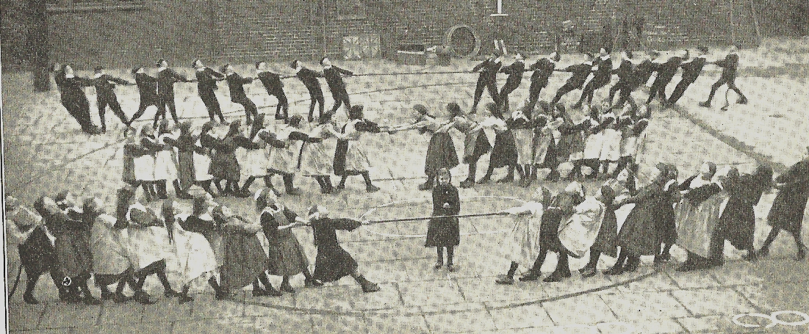
Better English and Literacy
Is there a whole-school approach?
Notes:
Wood, Robert S., Organized Games for the Playground, Macmillan and Co., Ltd., 1913
Not in copyright (In TNM Collection)

Slide 42
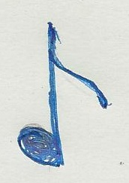
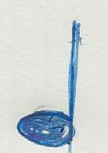
The challenge Better English and Literacy
‘It ain’t what you do - It’s the way that you do it… It ain’t (just) what you bring – It’s the way that you swing it… And that’s what gets results!’
Notes:
42
‘It ain’t what do you’ recorded by Ella Fitzgerald in 1939, published by MCA Music Ltd, 1939

